Slide 1

Reconfigurable Supercomputing @CHREC
Herman Lam
Associate Director, CHREC
University of Florida

Slide 2

Outline
Elevator Overview (30 – 40 secs. each)
RSC* Research on Novo-G
Real-Time, Feature-based Object Recognition
Behavioral Emulation for Future-Gen Systems
Sparse-Matrix Processor for Graph Apps
Reconfigurable Interconnects, Novo-G#
HLS** Studies
OpenCL vs. VHDL: Performance & Productivity Comparison
CMS+ Endcap L-1 Muon Trigger: Making a Case for HLS
HMC⁺ Studies
CMC: Custom Memory Cube
*Reconfigurable Supercomputing
**High-level Synthesis
⁺Hybrid Memory Cube
SC15 Booth 207 (www.chrec.org)

Slide 3
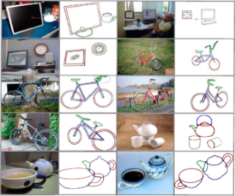
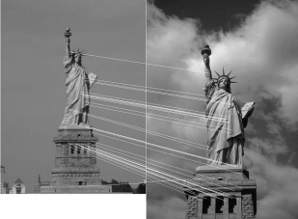
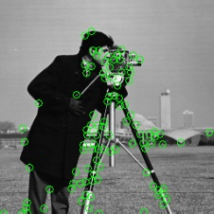
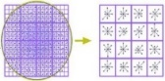
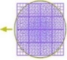
Real-Time, Feature-based Object Recognition
Goal: Develop power-efficient hardware architecture for onboard image processing
Motivation: Unsupervised decision making essential to many domains (safety, cost)
Feature match
Feature Extraction
& Segmentation
Feature
Description
Feature Matching
& Classification
Mean-Shift unsupervised image segmentation algorithm
SURF feature extraction; Canny & Sobel edge detection
SURF feature-based object classification (future work)
Extracts scale-invariant features @ 280fps (Altera Stratix-V FPGA)
Describes scale- & rotation-invariant features @ 140fps (Stratix-IV)
Object recognition: organize labeled features using a balanced kd-tree

Slide 4

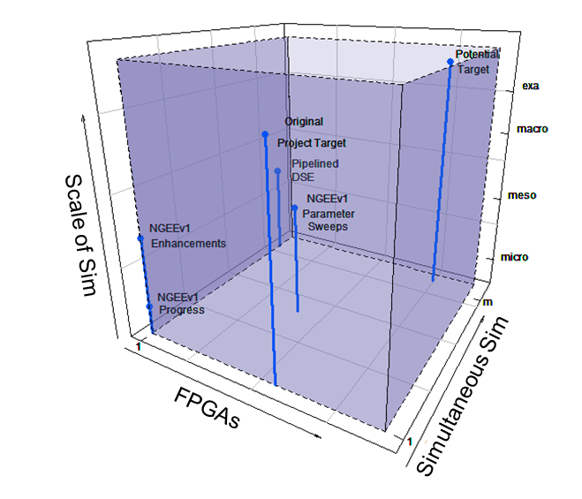
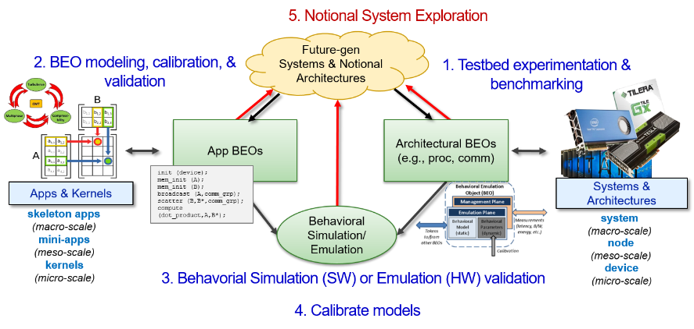
Behavioral Emulation for Future-Gen Systems
Goal & Motivation
How to study future notional devices, nodes, & systems, up to Exascale without an existing Exascale system
Analytical studies
Software simulation
Behavioral Emulation
Cycle-accurate emulation
Prototype device
Prototype system
Approach
Manage Exascale complexity via Behavioral Emulation (BE)
Coarse-grained, multi-scale simulation approach to balance accuracy, speed, & scalability
BE Process
BE Platforms
SST*based BE platform
Experimental testbed to support algorithm DSE⁺ on future-gen archs
NGEE** BE platform
BE acceleration via FPGAs
*SST: Structural Simulation Toolkit, Sandia National Lab
**NGEE: Novo-G Exascale Emulation ⁺DSE: Design-Space Exploration

Slide 5
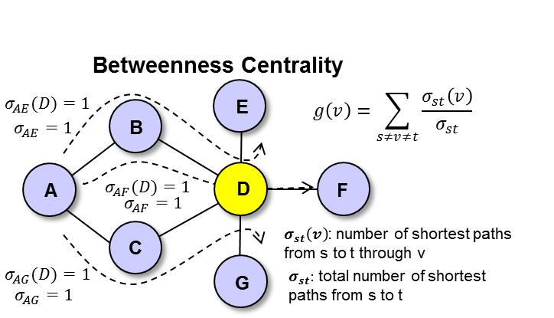
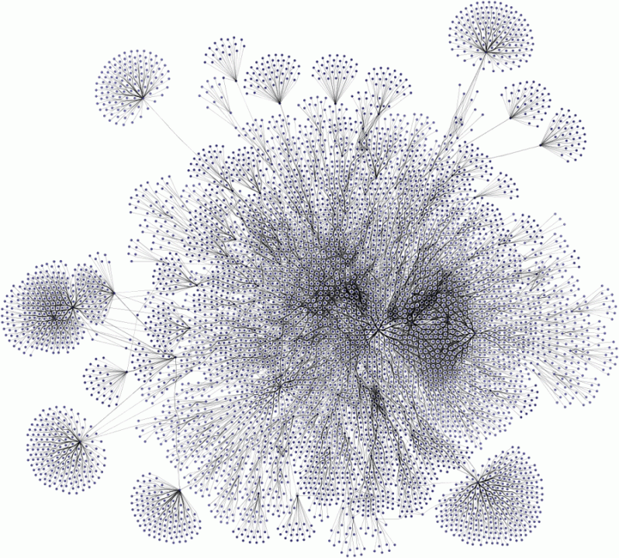
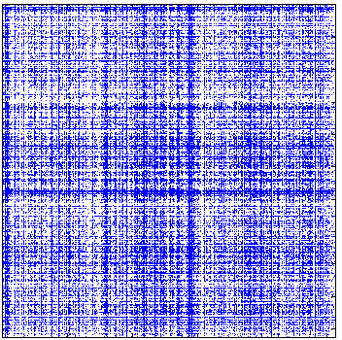
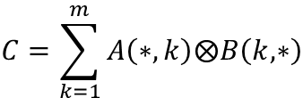
Sparse-Matrix Processor for Graph Apps
Goal: Develop scalable architectures
for accelerating graph processing in
the language of linear algebra
Motivation: Traditional architectures are poorly suited for the sparsity of graph datasets
$$C=\sum_{k=1}^{m}{A\left(∗,k\right)⨂B\left(k,∗\right)}$$
Adjacency Matrix Representation
FPGA-accelerated Operations
Accelerated Graph Algorithms
Approach
Develop custom architectures for distributed SpGEMM
Scale to multiple FPGAs leveraging Novo-G# interconnect
Outcomes
Developed optimized storage format and data-distribution techniques
Developed single-processor FPGA architecture for accelerated SpGEMM
SpGEMM – Sparse Generalized Matrix/Matrix Multiplication

Slide 6

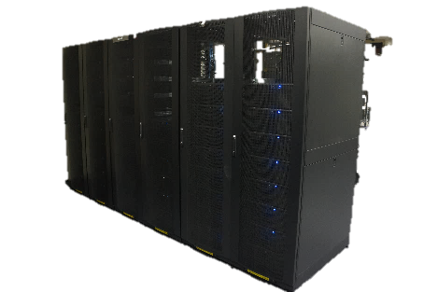
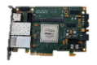

Reconfigurable Interconnects for Novo-G#
Goal: Enable large-scale app acceleration with a reconfigurable 3D-torus network
Motivation: Large-scale RSC apps are communication-bound
Turn communication-bound problems into computation-bound problems
Approach
Novo-G# network design to support multi-FPGA apps efficiently
40 Gbps link support, <10% FPGA util.
Modeling & simulation of novel topologies, architectures & protocols
Scalable, accurate VisualSim model avail.
OpenCL support for productive multi-FPGA development
BSP* with inter-FPGA channel support avail.
ProceV board
3D torus network stack
Novo-G#
64 Gidel ProceV (Stratix V D8)
3D torus or 6D hypercube
6 Rx-Tx links per FPGA
4x 10 Gbps per link
*BSP: Board-support package

Slide 7
Outline
Elevator Overview (30 – 40 secs. each)
RSC* Research on Novo-G
Real-Time, Feature-based Object Recognition
Behavioral Emulation for Future-Gen Systems
Sparse-Matrix Processor for Graph Apps
Reconfigurable Interconnects, Novo-G#
HLS** Studies
OpenCL vs. VHDL: Performance & Productivity Comparison
CMS+ Endcap L-1 Muon Trigger: Making a Case for HLS
HMC⁺ Studies
CMC: Custom Memory Cube
*Reconfigurable Supercomputing
**High-level Synthesis
⁺Hybrid Memory Cube

Slide 8
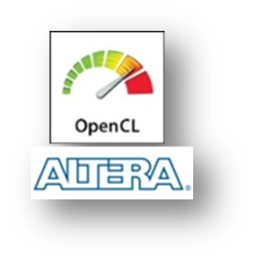
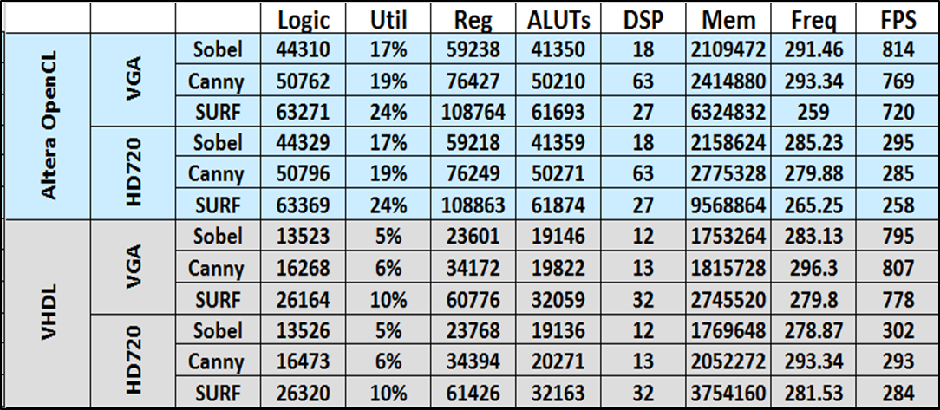
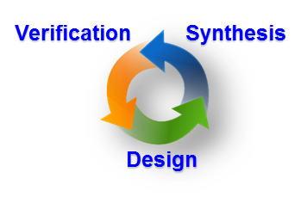
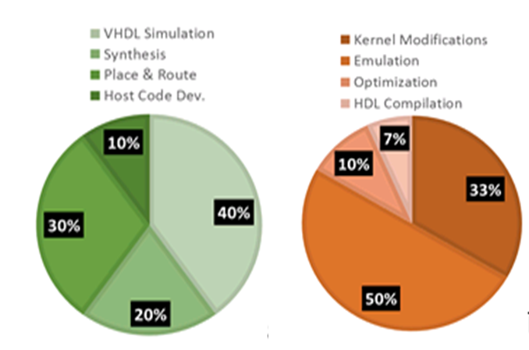
OpenCL* vs. VHDL
Performance & Productivity Comparison
HDL Design Flow
Low-level HDL at RTL level
Design verification (cycle-accurate simulation using HDL testbenches)
Place & route: hours+
Limited number of turns-per-day
*Altera OpenCL
OpenCL Design Flow
C-like syntax for FPGAs
Functional verification of project
Synthesis and PAR performed after kernel code is finalized
Increase number of turns-per-day
Conclusions - OpenCL:
Offers more productive design flow
Generates comparable clock frequencies
Uses more resources
Code portable across different platforms
Experimental Setup
VHDL design flow
Gidel ProceV-D8
OpenCL design flow
Gidel ProceV-D8, Nallatech P385-D5, Bittware S5-PHQ-D8, Altera OpenCL 14.0
Design
Productivity
Kernel design time
VHDL: 6 months
OpenCL: 1 month

Slide 9

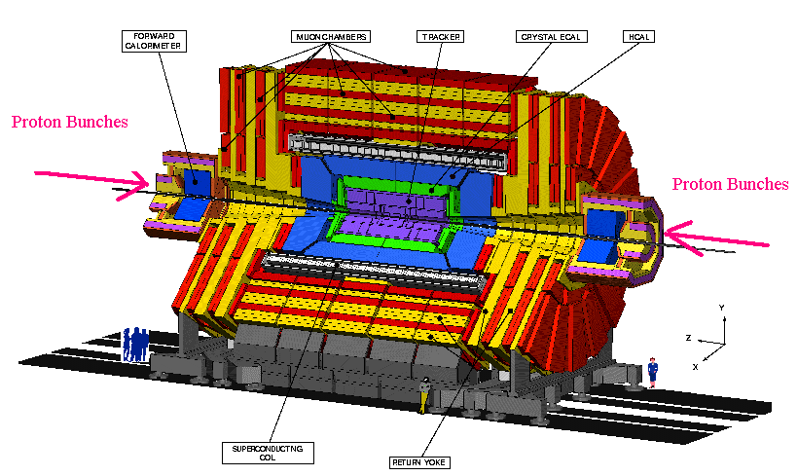



CMS* Endcap L-1 Muon Trigger
Making a Case for HLS
*CMS (Compact Muon Solenoid) experiment
at The Large Hadron Collider, CERN
Peta-bytes of data on every bunch crossing @40MHz (every 25 ns)
FPGA-based design to reduce event rate to ~100KHz
Challenges
Goal
Outcomes
Current version in Verilog (HDL)
Took several years
> 4000 lines
Development & maintenance
Complexity rapidly increasing
Verification for scientists
Manually converted to C++
Increasingly difficult & inconsistent
Explore use of HLS languages & tools for next-gen CMS code
Very promising thus far
Vivado HLS C/C++ entry improved productivity
Hardware optimization via HLS a challenge
Verification: C++ code can be compiled using g++ compiler
No need for manual conversion from HDL
Design tool: Vivado HLS
Xilinx Virtex-7 XC7VX690T

Slide 10

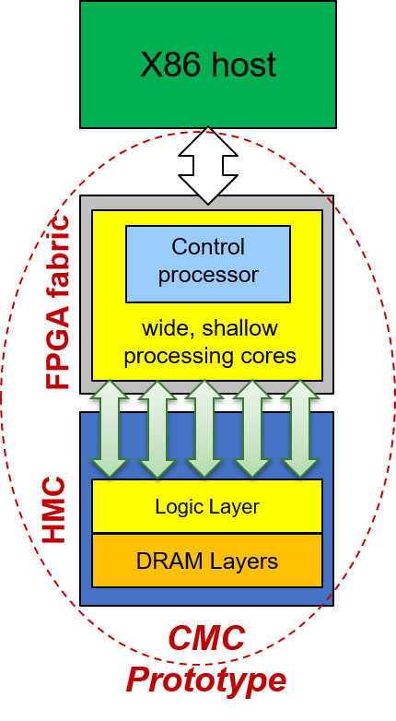
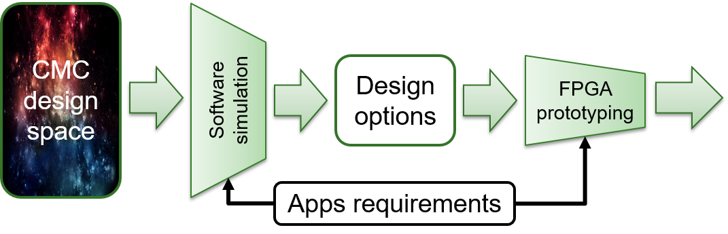
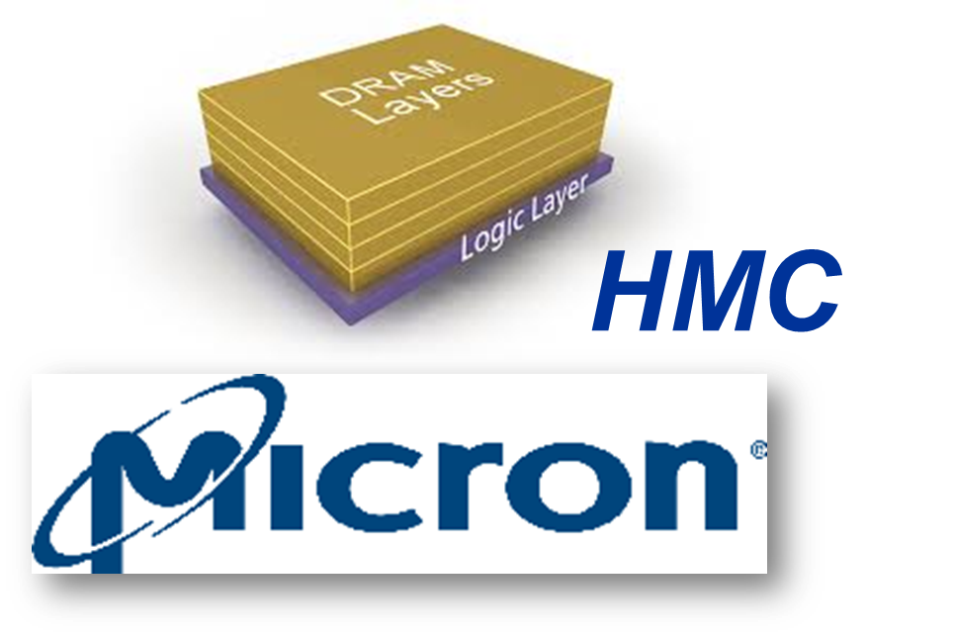
Custom Memory Cube (CMC)
Goal: Explore potential of customizable logic layer for HMC
Concepts of C-RAM* & PIM** (e.g., SIMD, ARM64, & RISC-V in logic layer)
Approach: Prototype CMC using FPGA/HMC boards
Testbeds for CMC Research:
Software simulators
Gem5
Goblin core64
SST⁺
Processor testbeds
JUNO ARM64 development platform
RISC-V: Rocket Core on Zedboard
FPGA/HMC boards
Convey Merlin (MA-100)
PICO EX500 w/ AC510 modules
*C-RAM: Computational Memory **PIM: Processor in Memory
⁺SST: Structural Simulation Toolkit, Sandia National Lab

Slide 11

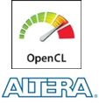
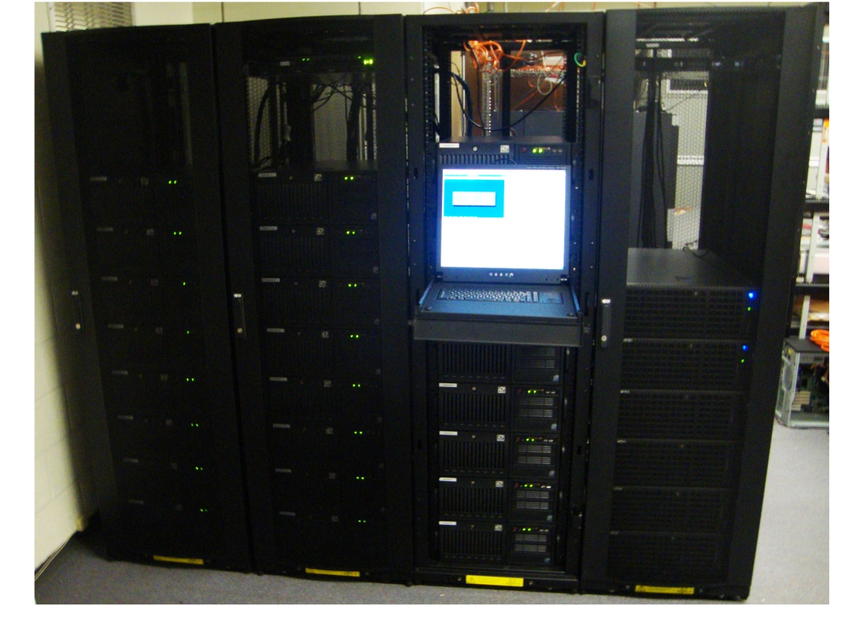
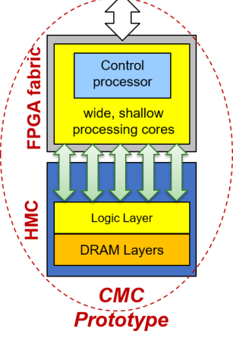

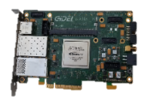

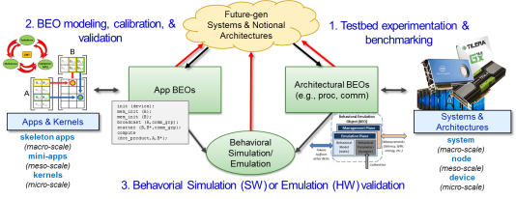
Conclusions
Much going on !!
In reconfigurable supercomputing
@ CHREC
Come see us!!
Novo-G#
SC15 Booth 207 (www.chrec.org)

